Slide 1
UNIT- V APPLICATION ANALYSIS

Slide 2
CONTENTS
Application interaction model
Application class model
Overview of class design.

Slide 3
Application Interaction Model
Most domain models are static and operations are unimportant.
After completing the domain model we then shift our attention to the details of an application and consider interaction
Interaction modeling is used to determine the overall boundary of the system
Identification of use cases and flesh them out with scenarios and sequence diagrams
Prepare activity diagrams for use cases

Slide 4
Steps To Construct An Application Interaction Model (DFFF PAF POC)
Q. Elucidate in brief the steps involved in the application interaction modeling. (L-2,CO-3,PO-1,10m)
One can construct an application interaction model with the following steps.
■ Determine the system boundary. [13.1.1]
■ Find actors. [13.1.2]
■ Find use cases. [13.1.3]
■ Find initial and final events. [13.1.4]
■ Prepare normal scenarios. [13.1.5]
■ Add variation and exception scenarios. [13.1.6]
■ Find external events. [13.1.7]
■ Prepare activity diagrams for complex use cases. [13.1.8]
■ Organize actors and use cases. [13.1.9]
■ Check against the domain class model. [13.1.10]

Slide 5
1. Determine the system boundary (DFFF PAF POC)
One should know the boundary of the system—in order to specify functionality.
This means that you must decide what the system includes and, more importantly, what it doesn't include.
ATM example: –
Focus on ATM behavior
ignore cashier details.

Slide 6

2. Find actors(DFFF PAF POC)
Once you determine the system boundary, you must identify the external objects that interact directly with the system.
These are its actors.
Actors include humans, external devices, and other software systems.
Example for ATM application
actors are
1. Customer
2. Bank
3. Consortium.

Slide 7
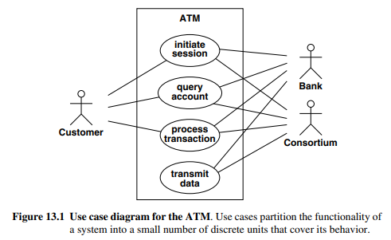
Finding Use Cases(DFFF PAF POC)
For each actor, list the fundamentally different ways in which the actor uses the system. Each of these ways is a use case
Each use case should represent a kind of service that the system provides—something that provides value to the actor.

Slide 8
Finding Use Cases
From the previous diagram
Initiate session. The ATM establishes the identity of the user and makes available a list of accounts and actions.
Query account. The system provides general data for an account, such as the current balance, date of last transaction, and date of mailing for last statement.
Process transaction. The ATM system performs an action that affects an account’s balance, such as deposit, withdraw, and transfer. The ATM ensures that all completed transactions are ultimately written to the bank’s database.
Transmit data. The ATM uses the consortium’s facilities to communicate with the appropriate bank computers.

Slide 9
Find initial and final events(DFFF PAF POC)
Finding the initial and final events for each use case
To understand the behavior clearly of system
Initial events may be
a. A request for the service that the use case provides
b. An occurrence that triggers a chain of activity
You can start by finding the events that initiate each use case. Determine which actor initiates the use case and define the event that it sends to the system.
You should also determine the final event ,final events indicate completion
For ATM example. Here are initial and final events for each use case.
• Initiate session
– Initial event
• The customer’s insertion of a cash card.
--final event
• The system keeps the cash card, or
• The system returns the cash card.

Slide 10
Query account
– Initial event
• A customer’s request for account data.
– final event
• The system’s delivery of account data to the customer.
Process transaction
– Initial event
• The customer’s initiation of a transaction.
– final event
• Committing or
• Aborting the transaction
Transmit data
– Initial event
• Triggered by a customer’s request for account data, or
• Recovery from a network, power, or another kind of failure.
– final event
• Successful transmission of data.

Slide 11
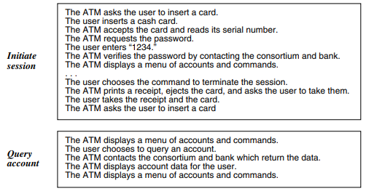
Preparing Normal Scenarios(DFFF PAF POC)
For each use case, prepare one or more typical dialogs.
A scenario is a sequence of events among a set of interacting objects.
Let us see some examples.
Normal ATM scenarios

Slide 12
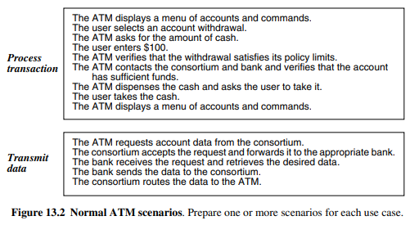
Preparing Normal Scenarios

Slide 13
Adding Variation and Exception Scenarios (DFFF PAF POC)
After you have prepared typical scenarios, consider “special cases and error cases”. ( SPECIAL ERROR OTHERS )
Special cases such as Omitted input E.g., maximum values, minimum value
Error cases E.g. Invalid values, failures to respond
Other cases E.g. Help requests, status queries
For ATM example. Some variations and exceptions follow.
The ATM can’t read the card.
The card has expired.
The ATM times out waiting for a response.
The amount is invalid.
The machine is out of cash or paper.
The communication lines are down.
The transaction is rejected because of suspicious patterns of card usage.

Slide 14
Finding External Events(DFFF PAF POC)
• The external events include
– All inputs,
– decisions,
– interrupts, and
– Interactions to or from users or external devices.
An event can trigger effects for a target object. (Defination of the events)
Use scenarios for normal events.
Internal computation (not events) steps are not events, except for computations that interact with the external world.
A transmittal of information to an object is an event.
For example, enter password is a message sent from external agent(from keyboard) User to application object ATM. Some information flows are implicit. Many events have parameters

Slide 15
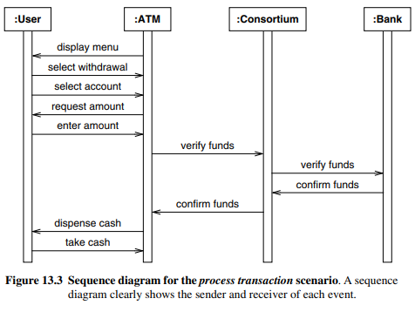
This comes in the external events
Sequence diagram
• Prepare a sequence diagram for each scenario.
• The sequence diagram captures the dialog and interplay between actors.
The sequence diagram clearly shows the sender and receiver of each event
ATM Example: Sequence diagram of the process transaction

Slide 16
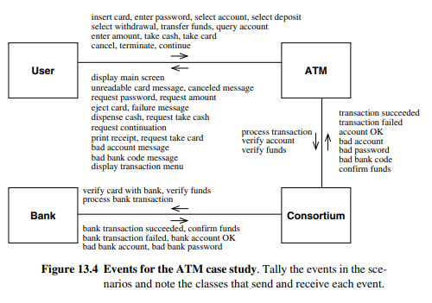
Events for the ATM case study (Important Diagrams)

Slide 17
Preparing Activity Diagrams for Complex Use Cases (dfff paf Poc)
Sequence diagrams capture the dialog and interplay between actors, but they do not clearly show alternatives and decisions.
Example : When the user inserts a card, there are many possible responses. Some responses indicate a possible problem with the card or account; hence the ATM retains the card. Only the successful completion of the tests allows ATM processing to proceed.

Slide 18
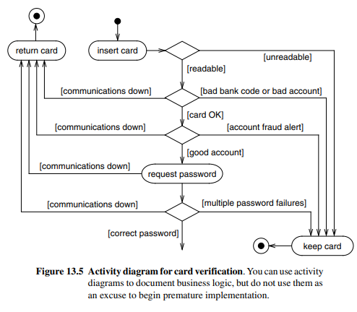
Activity diagram for card verification.
Comes under preparing the activity diagrams for complex usecases.

Slide 19
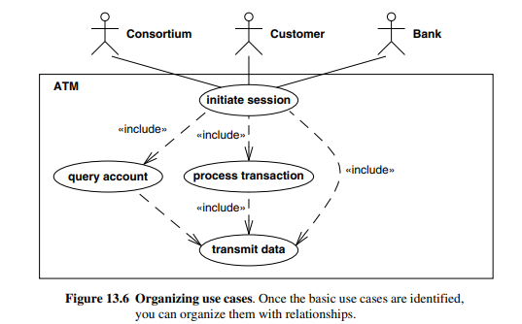
Organizing Actors and Use Cases(DFFF PAF POC)
The next step is to organize use cases with relationships (include, extend, and generalization) It is helpful for large and complex systems
ATM example. Figure 13.6 organizes the use cases with the include relationship.(Write any example for the complex use cases)

Slide 20
Checking Against the Domain Class Model(dfff paf poC)
The application(dynamic) and domain models(static in nature) should be mostly consistent.
The actors, use cases, and scenarios are all based on classes and concepts from the domain model.
Cross check the application and domain models to ensure that there are no inconsistencies.
Examine the scenarios and make sure that the domain model has all the necessary data.
Also make sure that the domain model covers all event parameters.

Slide 21
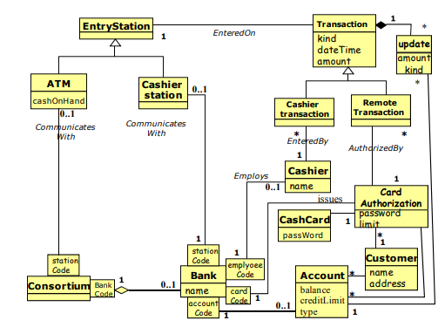
Domain class model for ATM Example.

Slide 22
Application Class Model
Application classes define the application itself, rather than the real-world objects that the application acts on
4 steps → mneumonics (SDDC) Sach DaD Chudi
Most application classes are computer-oriented and define the way that users perceive the applications
Application Class Model – steps
1. Specify user interfaces
2. Define boundary classes
3. Determine controllers
4. Check against the interaction model

Slide 23
Specify user interfaces
User interface
a. Is an object or group of objects
b. Provide user a way to access system’s
i. domain objects,
ii. commands, and
iii. Application options.
Try to determine the commands that the user can perform.
A command is a large-scale request for a service,
c. E.g.
i. Make a flight reservation
ii. Find matches for a phrase in a database Decoupling application logic from the user interface.
ATM example - The details are not important at this point.
• The important thing is the information exchanged.

Slide 24
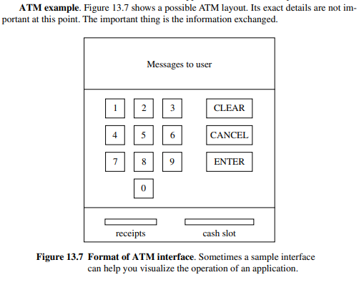
Comes under the application class models (Sach DaD Chudi)

Slide 25
2. Defining Boundary Classes
• A boundary class
– Is an area for communications between a system and external source.
– Converts information for transmission to and from the internal system.
• ATM example
• CashCard Boundary
• Account Boundary
– Between the ATM and the consortium

Slide 26
3. Determining Controllers
• Controller is an active object that manages control within an application.
• Controller
Receives signals from the outside world or
Receives signals from objects within the system,
Reacts to them,
Invokes operation on the objects in the system, and
Sends signals to the outside world.
ATM Example
• There are two controllers for ATM ex.
– The outer loop verifies customers and accounts.
– The inner loop services transactions.

Slide 27
4.Checking Against the Interaction Model
Go over the use cases and think about how they would work.
When the domain and application class models are in place, you should be able to simulate a use case with the classes. (very important point in the pocket bro !!!)
ATM Example
ATM example. Figure 13.8 shows a preliminary application class model and the domain classes with which it interacts. There are two interfaces—one for users and the other for communicating with the consortium. The application model just has stubs for these classes, because it is not clear how to elaborate them at this time.

Slide 28
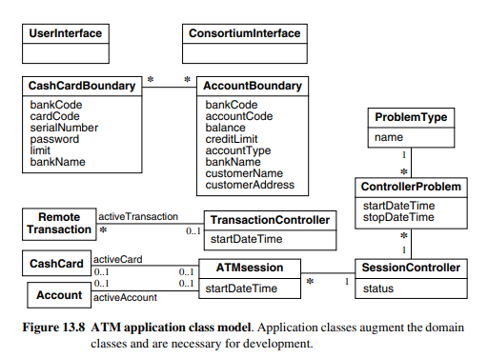

Slide 29
Overview of Class Design
Review of Analysis: Domain analysis and Application analysis
The analysis model describes the information that the system must contain at high level operations that it must perform.
The purpose of class design is to complete the definition of classes and association and choose algorithms and operation.
The simplest and best approach is to carry out analysis classes directly to design

Slide 30
Overview of Class Design
During design, you choose among different ways to realize the analysis classes with an eye toward minimizing execution time, memory, and other cost measures.
You can introduce new classes to store intermediate results during program execution and avoid recomputation.
OO design is an iterative process.

Slide 31
Overview of Class Design(BR FRR ORAO)
Class design involves the following steps.
■ Bridge the gap from high-level requirements to low-level services.
■ Realize use cases with operations.
■ Formulate an algorithm for each operation.
■ Recurse downward to design operations that support higher-level operations.
■ Refactor the model for a cleaner design.
■ Optimize access paths to data.
■ Reify behavior that must be manipulated.
■ Adjust class structure to increase inheritance.
■ Organize classes and associations.

Slide 32
THANK YOU

